Slide 1
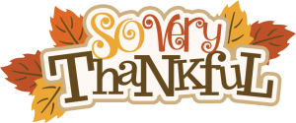
Bellringer
As we prepare to head into Thanksgiving Break, reflect on the question below and record your thoughts in your Bell Work sheet in your Class Notebook.
What are you most thankful for?

Slide 2
Q1 Grade Recovery
For those of you who did not earn a passing grade for quarter 1, you should see a new assignment in Teams titled “Q1 Grade Recovery.”
This assignment focuses on standards and thematic concepts addressed throughout Unit 1.
The assignment will be graded based on accuracy, so make sure to do your BEST work.
Also remember that plagiarism will result in your losing this opportunity to improve your grade AND an Honor Code violation will be reported to administration at GHS.
This assignment MUST be completed by January 25, 2021; HOWEVER, I recommend completing it over Thanksgiving Break while you have time to focus with fewer distractions.

Slide 3
Subject-Verb Agreement Practice

Slide 4
Lesson Objective
SWBAT demonstrate command of the conventions of standard English grammar and usage when writing IOT convey specific meaning and add variety, interest, and accuracy to writing.

Slide 5
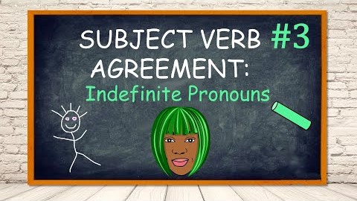

Slide 6
Today’s Assignment
Find the “Subject-Verb Agreement Practice” assignment in Teams.
Click on the Forms link.
Complete the practice exercise.
This is formatted like our assessments, but it will count as a Class Work grade.
You have the class period to complete your work.
Don’t forget to reference the instructional content at the top of the Forms link to help you out with examples.

